Slide 1

TelaLoc
How to use the app — a complete, step-by-step guide
COMPLETE CUSTOMER GUIDE

Slide 2
OVERVIEW
What's covered in this guide
Get Started
Home
Safety Tours
Download, log in, and complete the 7-step sign-up wizard.
Read your dashboard and check on a family member's location.
Plan a trip, set your route, and check in along the way.
9 screens
2 screens
5 screens
Emergency
Loved Ones
Support
Get help near you, call a helpline, or send an emergency capture.
Manage your family/loved ones circle and their contact details.
Report a problem straight to the TelaLoc team.
8 screens
2 screens
1 screen
TelaLoc · How to use the app
02

Slide 3
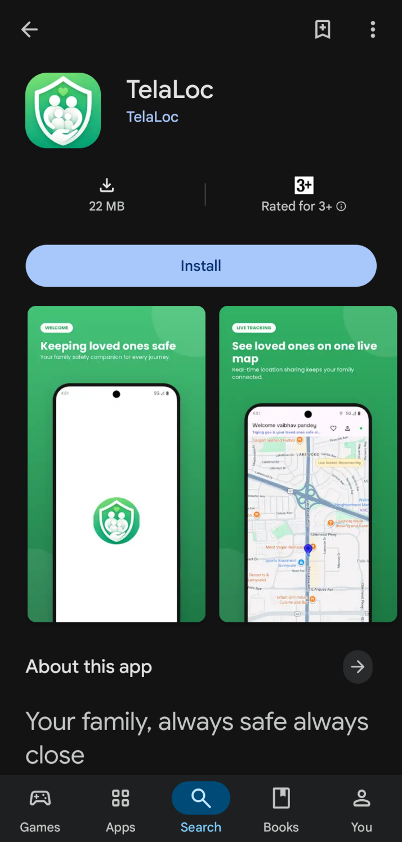
GET STARTED
Download the app
i
Download TelaLoc from the Play Store to get started.
TelaLoc · How to use the app
03

Slide 4
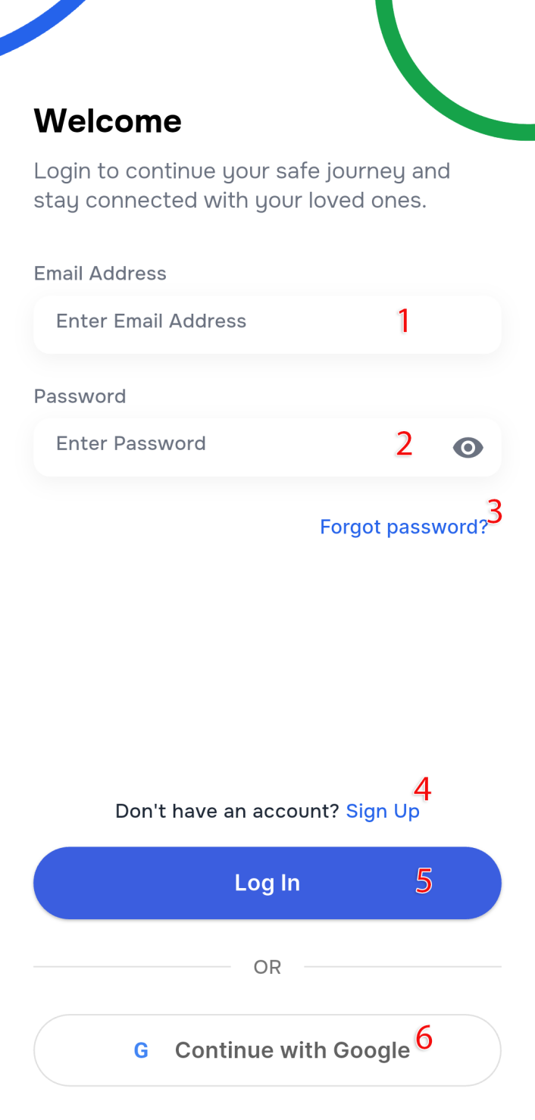
GET STARTED
Log in to your account
1
Enter your email address, if you already have an account.
2
Enter the password for your registered account — tap the eye icon to show/hide it.
3
Forgot your password? Tap this link to reset it.
4
New to TelaLoc? Tap “Sign Up” to create an account.
5
Entered your details? Tap “Log In” to continue.
6
You can also log in directly using your Google account.
TelaLoc · How to use the app
04

Slide 5
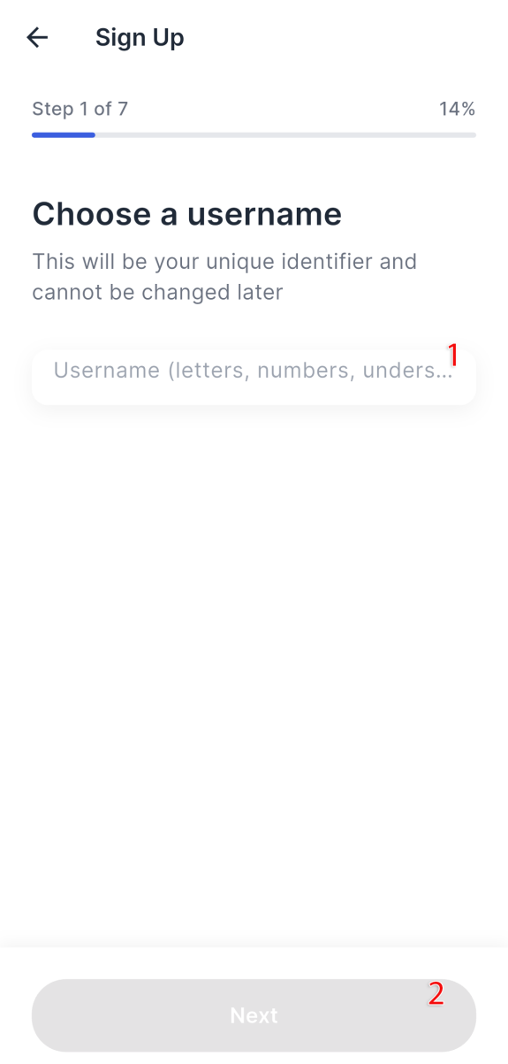
SIGN UP · STEP 1 OF 7
Choose a username
1
Select your unique username.
2
Tap “Next” to continue.
TelaLoc · How to use the app
05

Slide 6
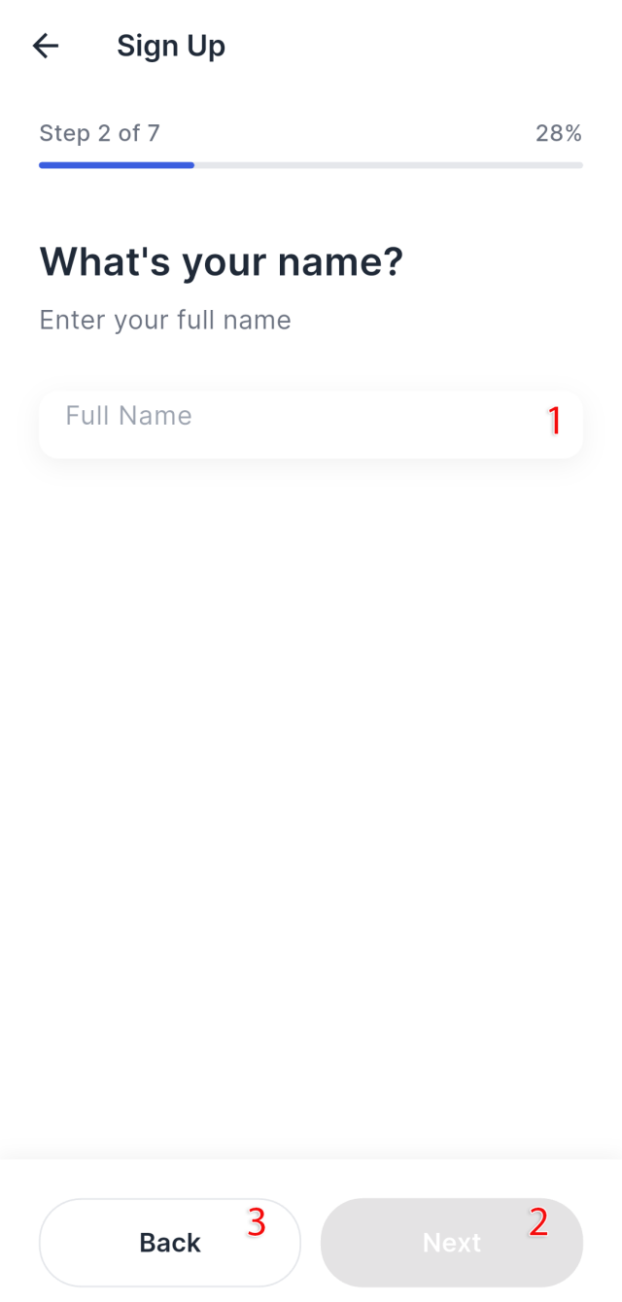
SIGN UP · STEP 2 OF 7
Enter your full name
1
Enter your full name.
2
Tap “Next” to continue to the next step.
3
Tap “Back” to return to the previous screen.
TelaLoc · How to use the app
06

Slide 7
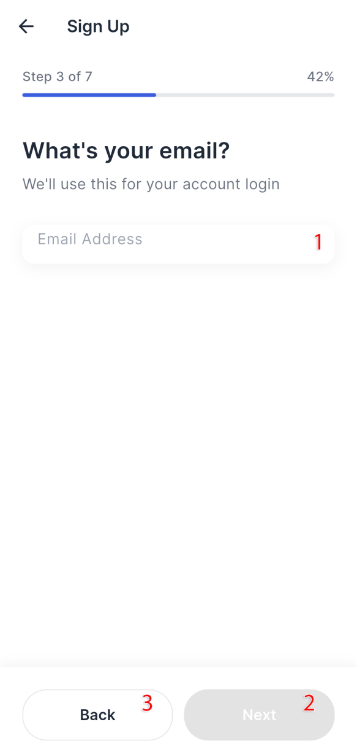
SIGN UP · STEP 3 OF 7
Add your email address
1
Enter your email address.
2
Tap “Next” to continue.
3
Tap “Back” to return to the previous screen.
TelaLoc · How to use the app
07

Slide 8
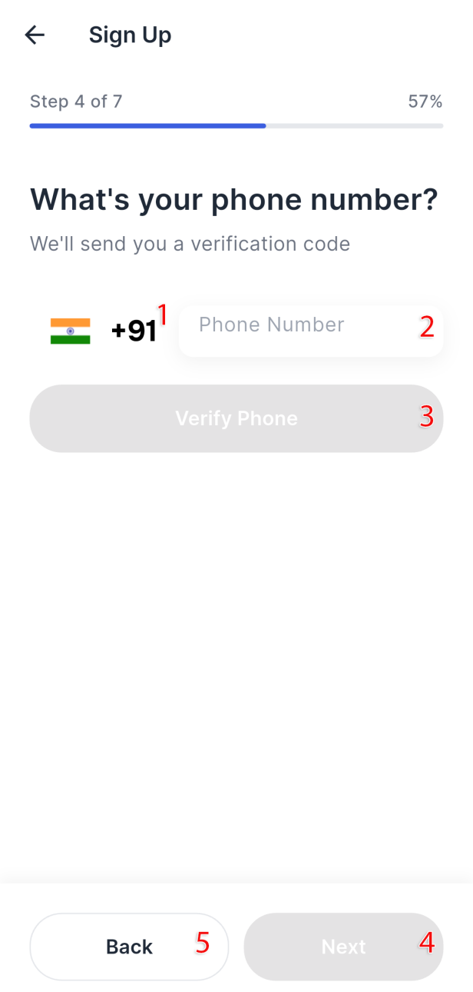
SIGN UP · STEP 4 OF 7
Verify your phone number
1
Select your country code.
2
Enter your 10-digit phone number.
3
Tap “Verify Phone” to receive an OTP.
4
Or tap “Next” to proceed.
5
Tap “Back” to return to the previous screen.
TelaLoc · How to use the app
08

Slide 9
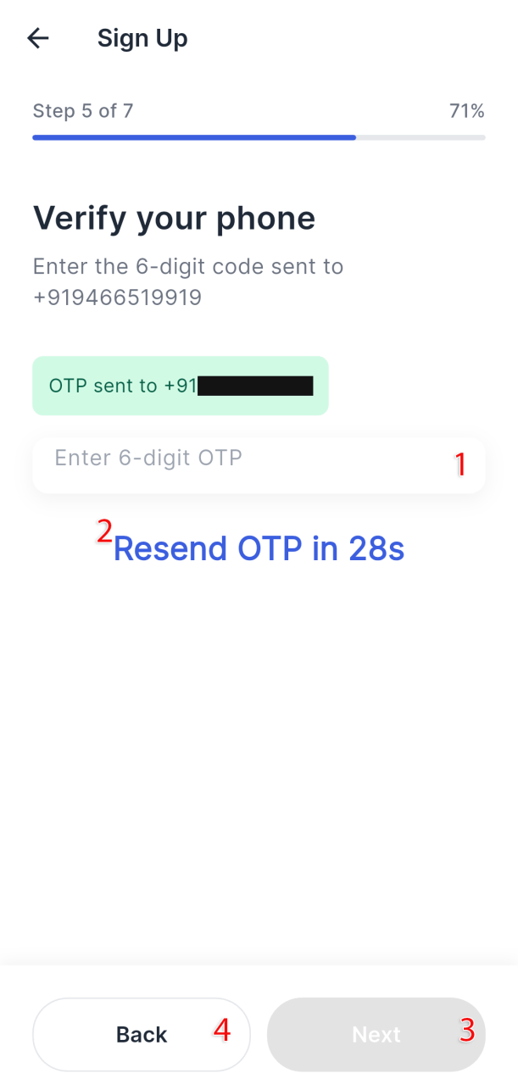
SIGN UP · STEP 5 OF 7
Enter the OTP
1
Enter the OTP you received on your phone number from the previous screen.
2
Use this if you don't receive the OTP after the timer runs out.
3
Tap “Next” to continue.
4
Tap “Back” to return to the previous screen.
TelaLoc · How to use the app
09

Slide 10
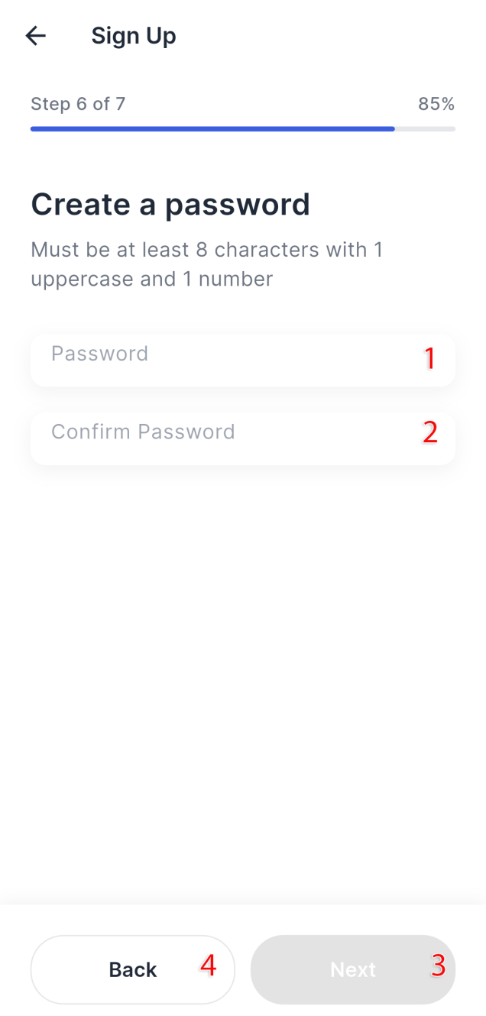
SIGN UP · STEP 6 OF 7
Create your password
1
Enter the password you want to create, following the restrictions shown above the field.
2
Re-enter the same password to confirm it.
3
Tap “Next” to continue.
4
Tap “Back” to return to the previous screen.
TelaLoc · How to use the app
10

Slide 11
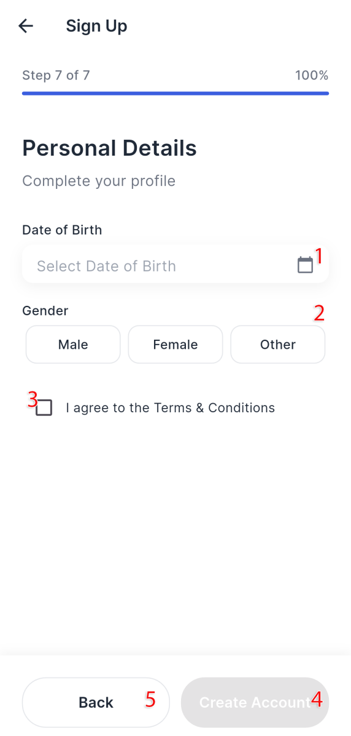
SIGN UP · STEP 7 OF 7
A few last details
1
Select your birth date from the calendar picker.
2
Select your gender.
3
Check the box to accept the Terms and Conditions.
4
Tap “Next” to create your account.
5
Tap “Back” to return to the previous screen.
TelaLoc · How to use the app
11

Slide 12
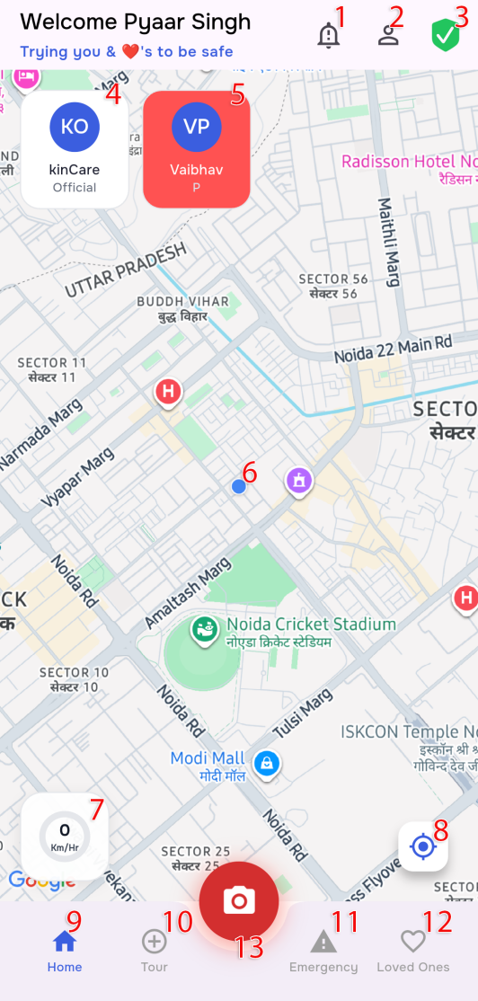
HOME
Your home dashboard
1
Notification bell — opens the window for emergency alerts you've sent and received.
8
Re-center the map on your current location.
2
Profile button — opens your profile so you can edit it.
9
Home button — returns to this page.
3
Health check — confirms your permissions, sensors, and connection to the server are all working.
10
Tour button — opens your Safety Tour details.
4
A family member whose live location is accessible and most likely safe (white means everything looks fine). Tap to center the map on their latest known location.
11
Emergency button — opens emergency helpline numbers and contacts.
5
A family member the server hasn't been able to reach for a while (red — worth checking on). Tap to center the map on their latest known location.
12
Loved Ones button — view or edit your family members list.
6
Your current location on the map.
13
Emergency camera button — opens the emergency window to share your current situation with your family for the fastest possible help.
7
Speedometer — measures your current geographical speed.
TelaLoc · How to use the app
12

Slide 13
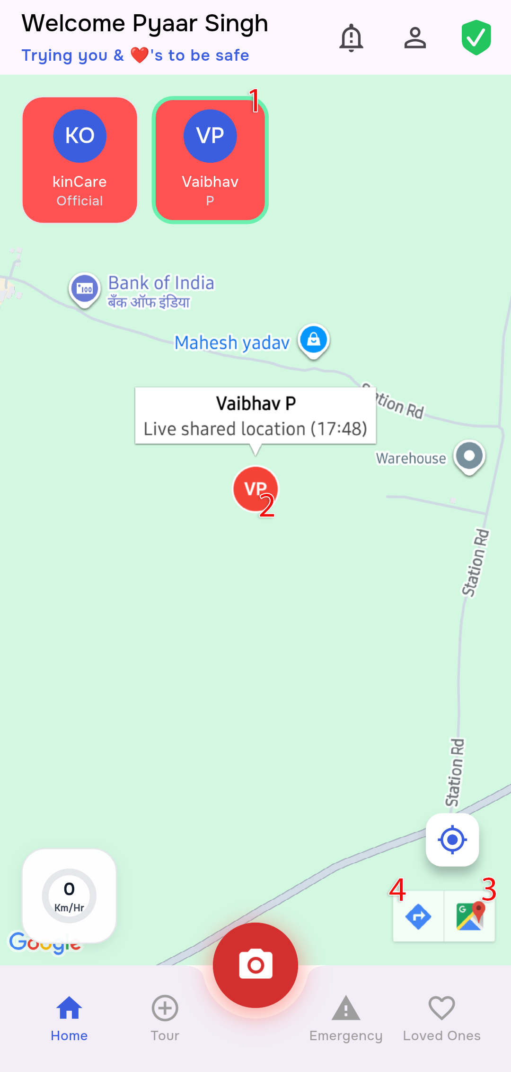
HOME
Check on a family member
1
Tap a family member's card in the horizontal list — the map centers on their shared location.
2
Tap the shared-location marker to see the time and status of that family member.
3
Tap this button to open the exact location in Google Maps.
4
Tap this button to get turn-by-turn directions to their location from where you are now.
TelaLoc · How to use the app
13

Slide 14
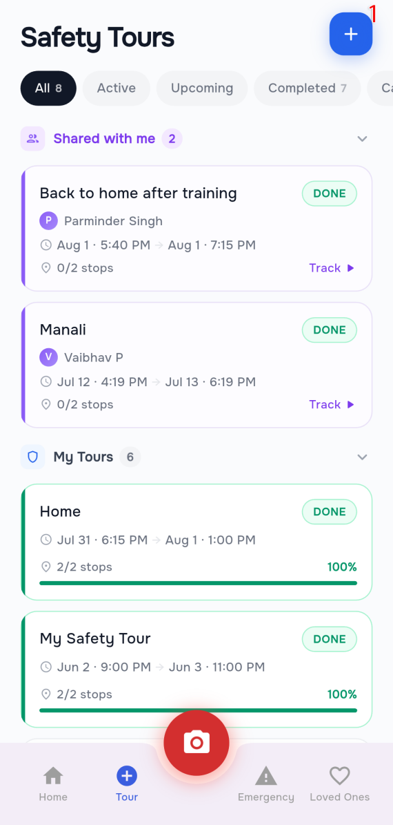
SAFETY TOURS
Your Safety Tours
1
See your upcoming, completed, and shared tours here. Tap “+” to create a new upcoming tour.
TelaLoc · How to use the app
14

Slide 15
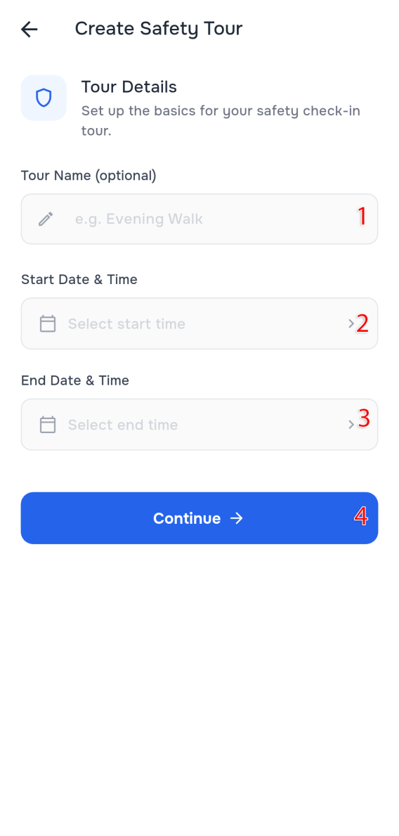
SAFETY TOURS · STEP 1 OF 3
Start creating a tour
1
Enter a tour name (optional).
2
Select the date and time for the tour to start.
3
Select the date and time the tour should end.
4
Tap “Continue” to move to the next step.
TelaLoc · How to use the app
15

Slide 16
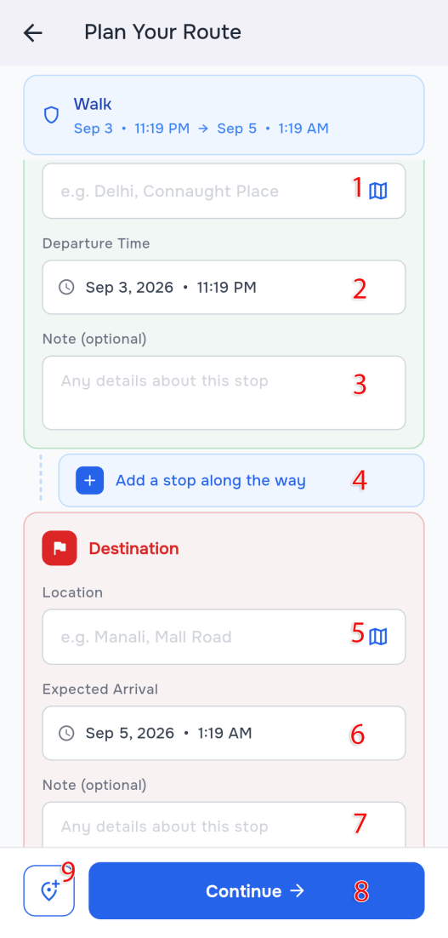
SAFETY TOURS · STEP 2 OF 3
Set your route
1
Tap to select your starting location from the map.
2
Select your start time.
3
Add details about the start location (optional).
4
Tap to add intermediate stops along the way.
5
Select your destination location from the map.
6
Select your expected arrival time at the destination.
7
Add details about the destination (optional).
8
Continue to the next step to select which family members to share the tour with.
9
Same behavior as button 4 — add another intermediate stop.
TelaLoc · How to use the app
16

Slide 17
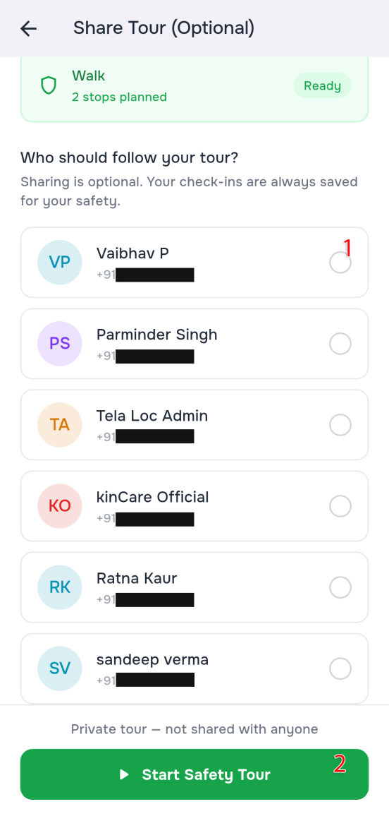
SAFETY TOURS · STEP 3 OF 3
Share your tour
1
Select which family members to share your tour details with.
2
Tap to create the tour.
TelaLoc · How to use the app
17

Slide 18
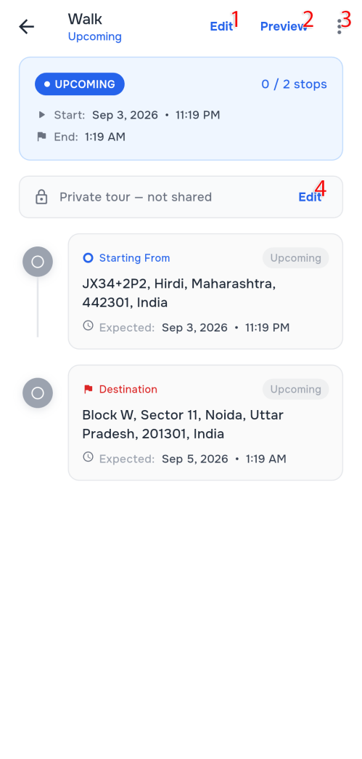
SAFETY TOURS
Edit an existing tour
1
Edit your tour's locations.
2
This feature is currently under construction.
3
Cancel or delete the tour.
4
Edit which family members the tour is shared with.
TelaLoc · How to use the app
18

Slide 19
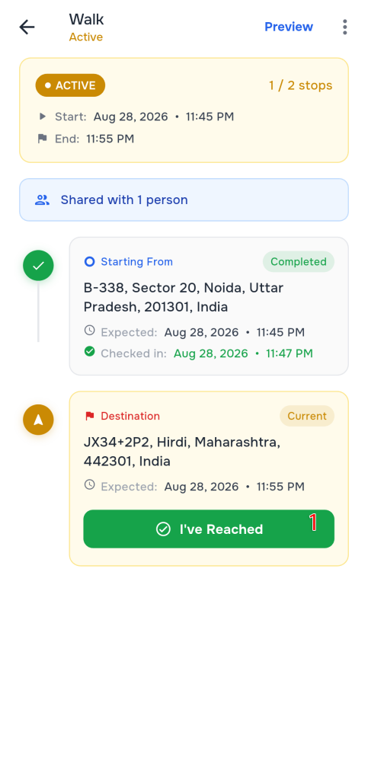
SAFETY TOURS
Check in during your tour
1
Update which stop you've reached — your shared family members are informed automatically.
TelaLoc · How to use the app
19

Slide 20
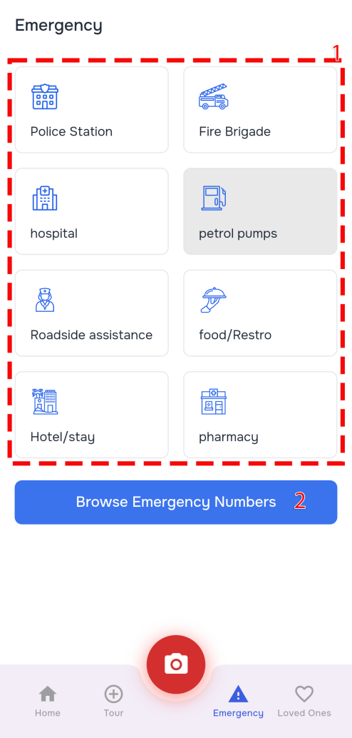
EMERGENCY
Find help near you
1
Select any type of help you need — you'll be taken to Google Maps with the nearest options.
2
Tap to open the helpline numbers screen.
TelaLoc · How to use the app
20

Slide 21
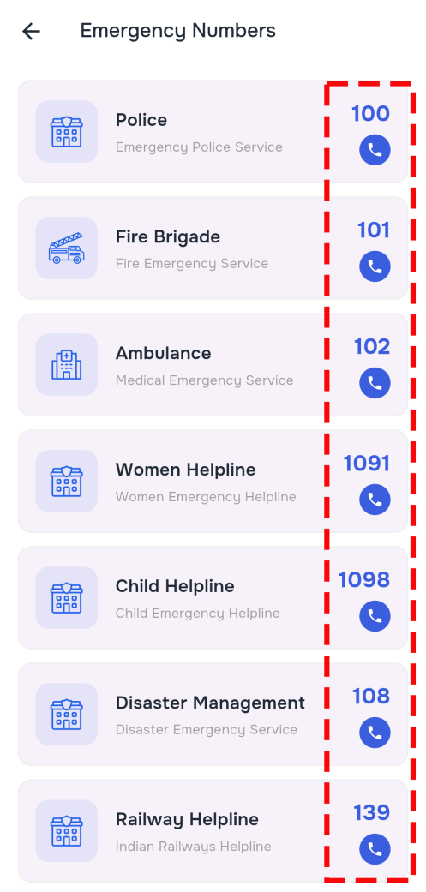
EMERGENCY
Call a helpline number
1
Tap any listed number to call that helpline directly.
TelaLoc · How to use the app
21

Slide 22
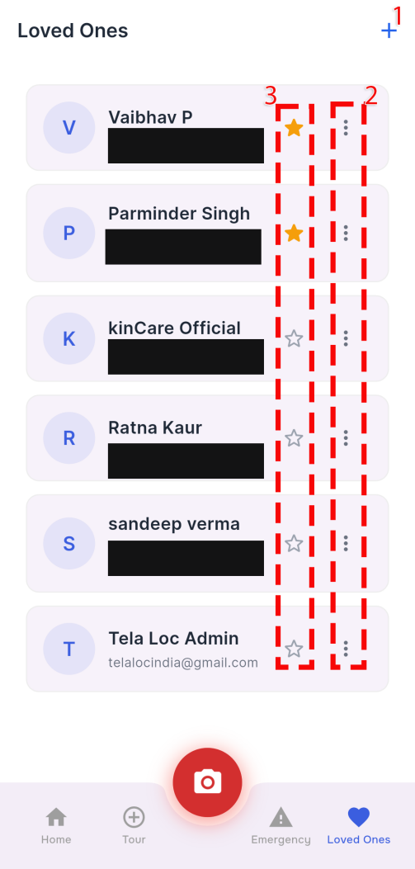
LOVED ONES
Your family members list
1
Add a new member to your family / loved ones group.
2
Share your live/virtual location with that person.
3
Mark that person as a favourite.
TelaLoc · How to use the app
22

Slide 23
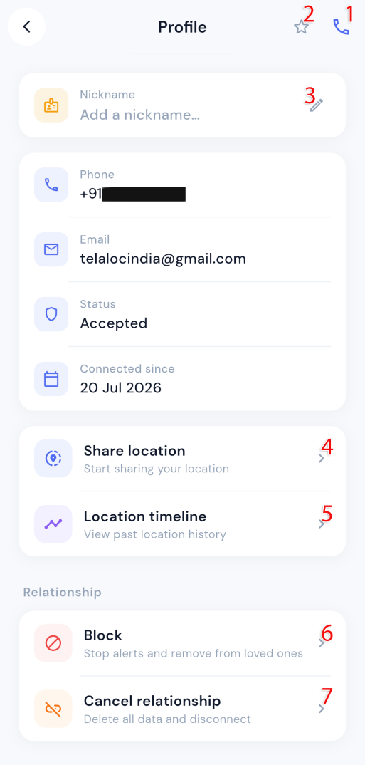
LOVED ONES
A loved one's contact details
1
Make a direct call to this person.
2
Mark them as a favourite.
3
Add or edit a nickname for them.
4
Share your live/virtual location with them.
5
This feature is currently under construction.
6
Block this person — they won't be able to send you requests.
7
Remove them from your loved ones group.
TelaLoc · How to use the app
23

Slide 24
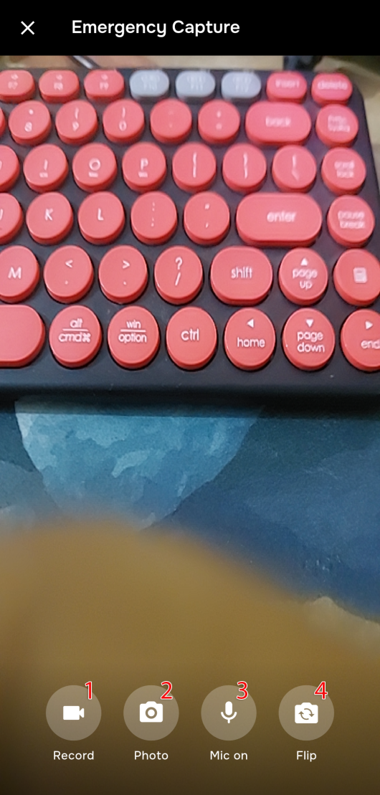
EMERGENCY CAPTURE
Capture an emergency
1
Start recording an emergency video.
2
Take a photo of the emergency situation.
3
Mute the microphone.
4
Flip the camera.
TelaLoc · How to use the app
24

Slide 25
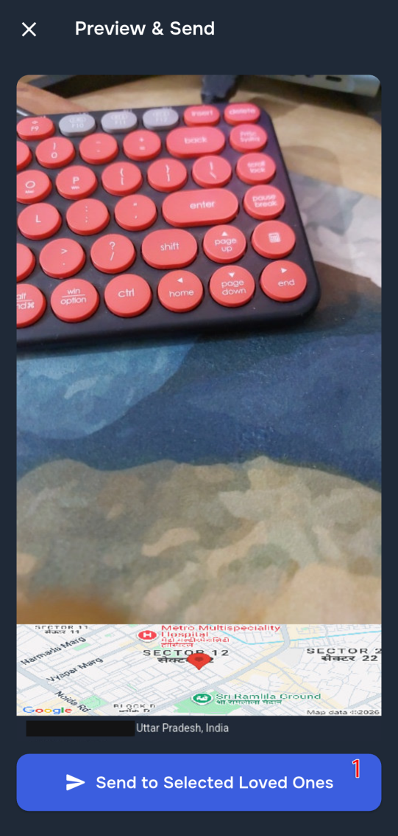
EMERGENCY CAPTURE
Review before sending
1
Continue to the next screen to select which family members to inform about the emergency.
TelaLoc · How to use the app
25

Slide 26
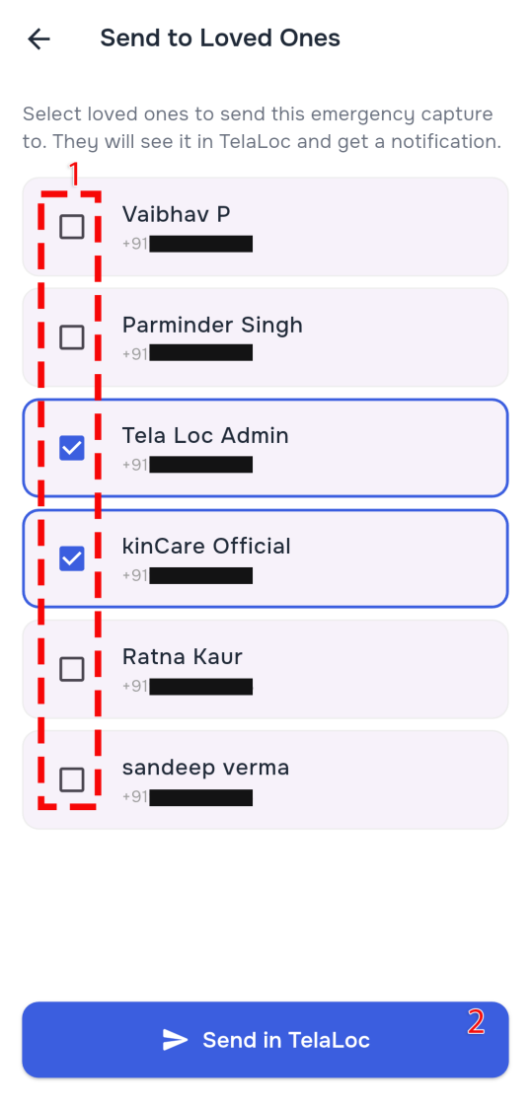
EMERGENCY CAPTURE
Choose who to notify
1
Select the contacts you want to notify.
2
Send the emergency information to the selected people as a notification.
TelaLoc · How to use the app
26

Slide 27
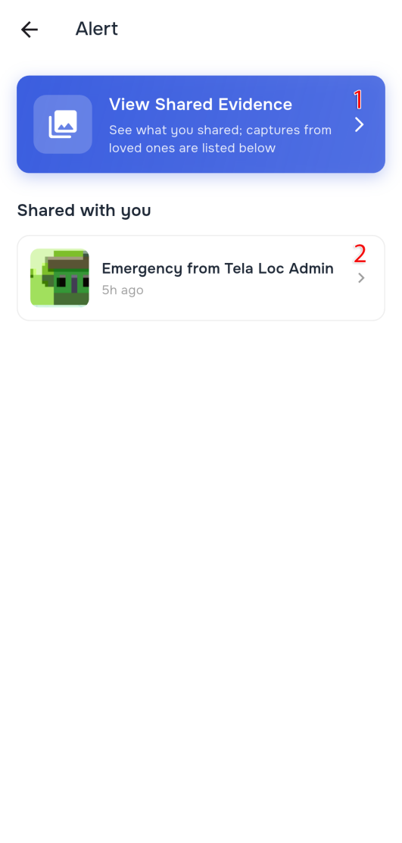
EMERGENCY
Emergency notifications
1
See the list of emergencies you've shared with your group.
2
See emergency information received from your group.
TelaLoc · How to use the app
27

Slide 28
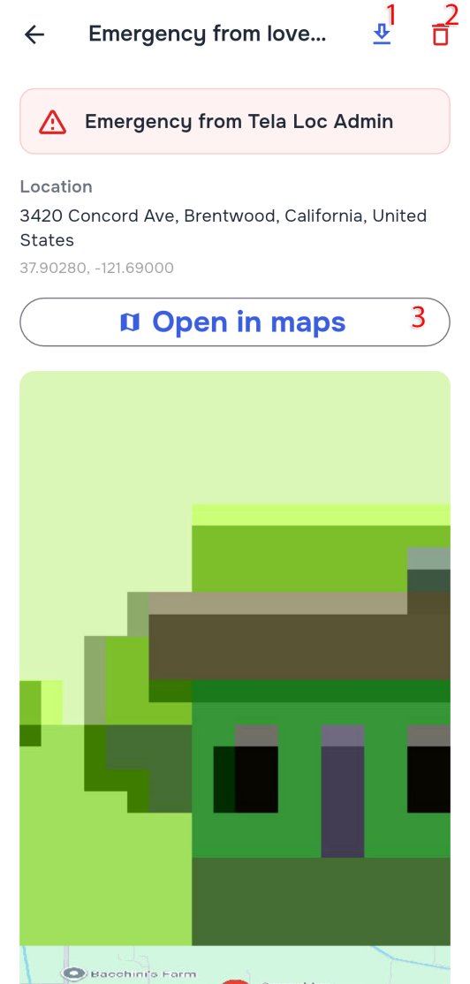
EMERGENCY
View emergency details
1
Download the shared media.
2
Delete the information.
3
Open the shared coordinates in Google Maps.
TelaLoc · How to use the app
28

Slide 29
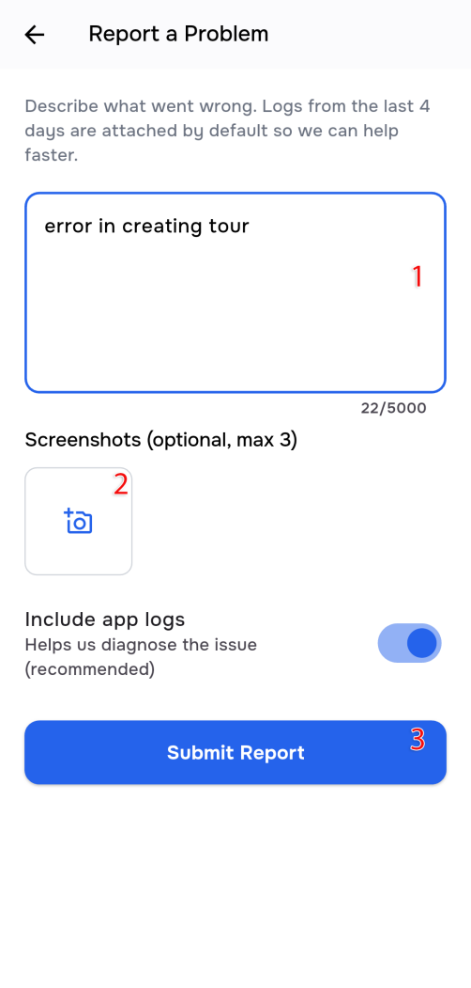
SUPPORT
Report a problem
i
Shake your phone 5–6 times continuously to open the error-report screen.
1
Describe the error you ran into.
2
Upload screenshots of the error.
3
Submit the details to the TelaLoc developers.
TelaLoc · How to use the app
29

Slide 30
Ready to stay connected
From your first login to your first Safety Tour and emergency alert —
you now know exactly how TelaLoc keeps your circle informed.
Ran into an issue?
Shake your phone 5–6 times anywhere in the app to report it directly to our team.

